Slide 1
Java Installed Structure

Slide 2
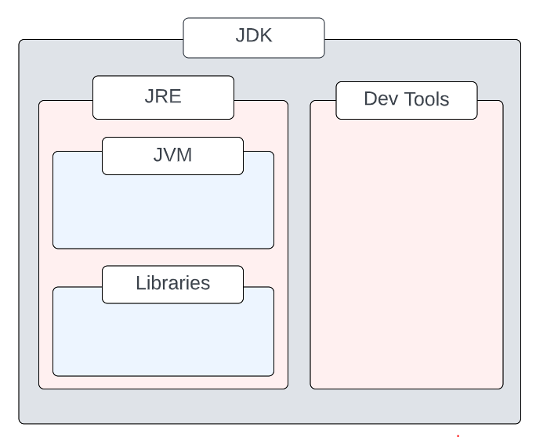
Java Structure
JDK = JRE + tools to develop Java Application
JRE = JVM + libraries to run Java application

Slide 3
JVM
JVM acts as interpreter in JAVA
Libraries
These libraries are just a collection of classes which are predefined in JAVA.

Slide 4
JRE
The Java Runtime Environment (JRE) is a software package which bundles the libraries (jars) and the Java Virtual Machine To run applications written in java
With out JRE we can not run the Java program

Slide 5
JDK
Development Tools
Development tools are used for developing, debugging, and monitoring Java applications.
Compiler, Jar creation are some of tools.

Slide 6
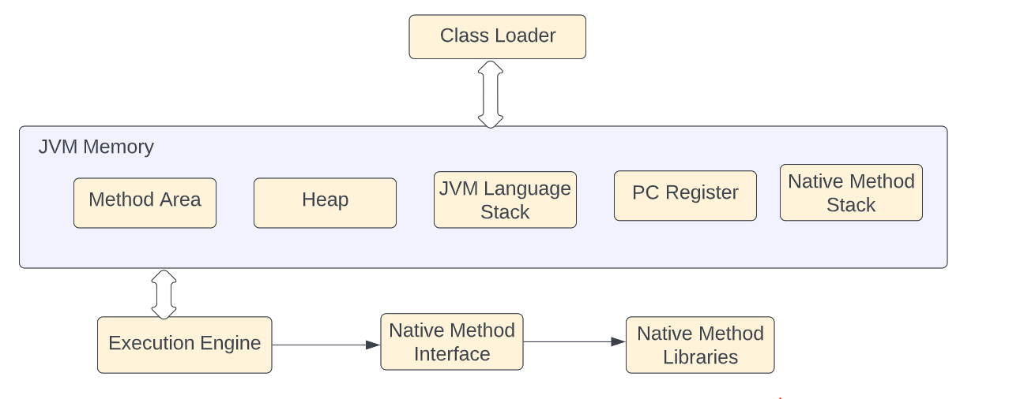
JVM Architecture

Slide 7
Class Loader
The class loader is used for loading the class files.
Three Phases of Class loader are
Loading
BootStrap
Extension
Application
Linking
initialization

Slide 8
Execution Engine
Interpreter
JIT compiler
Garbage collector

